Slide 1
Network Fundamentals – Lecture 3
Application Layer

Slide 2
Objectives
Define the application layer as the source and destination of data for communication across networks.
Explain the role of protocols in supporting communication between server and client processes.
Describe the features, operation, and use of well-known TCP/IP application layer services (HTTP, DNS, SMTP).

Slide 3
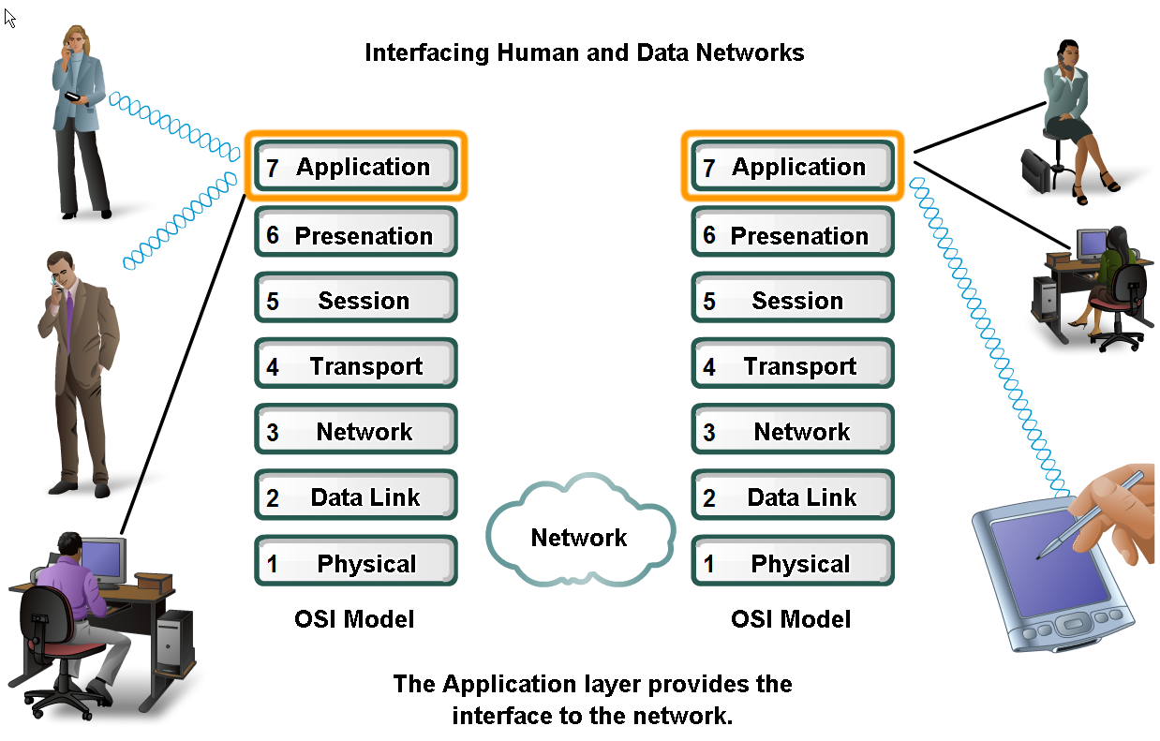
Applications – The Interface Between Human and Data Networks
Applications provide the means for generating and receiving data that can be transported on the network

Slide 4
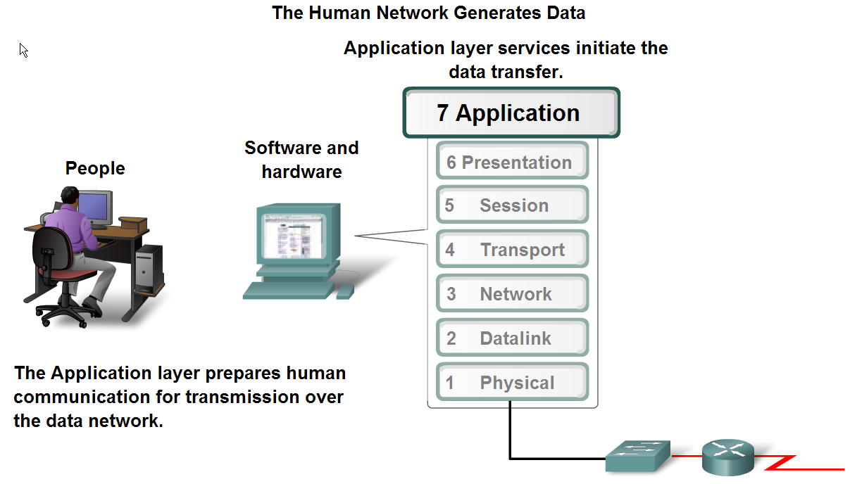
Applications – The Interface Between Human and Data Networks

Slide 5
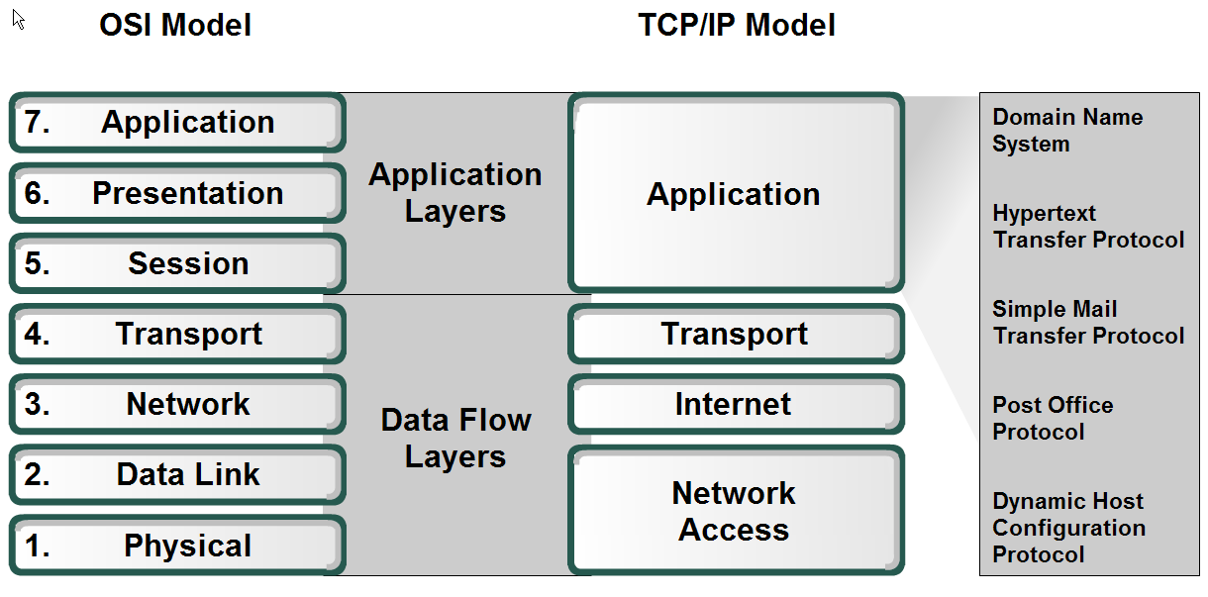
Applications – The Interface Between Human and Data Networks
Applications, services and protocols have separate roles in transporting data through networks

Slide 6
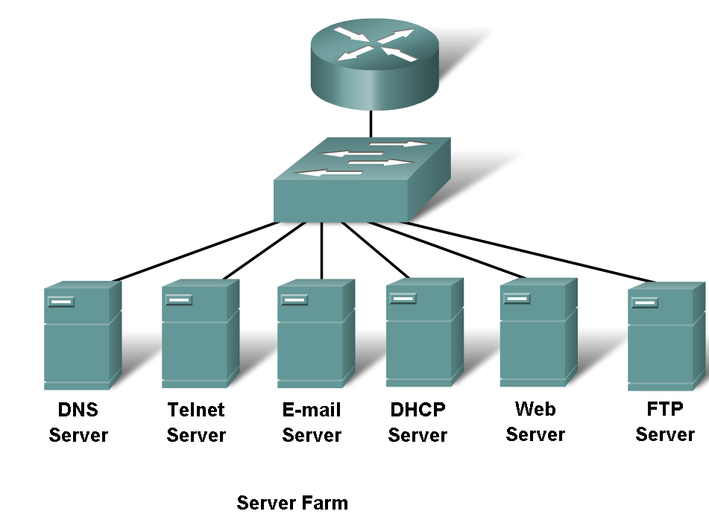
Applications – The Interface Between Human and Data Networks
Protocols identify different message properties that can be defined by a protocol

Slide 7
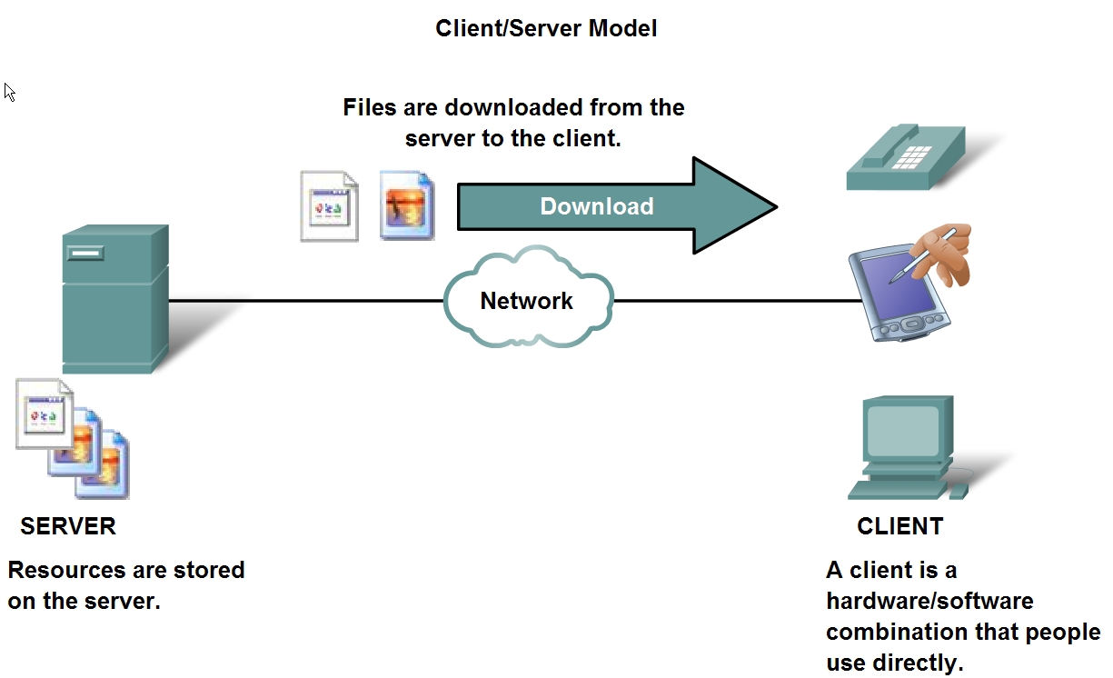
Client and server run different processes in data networks

Slide 8
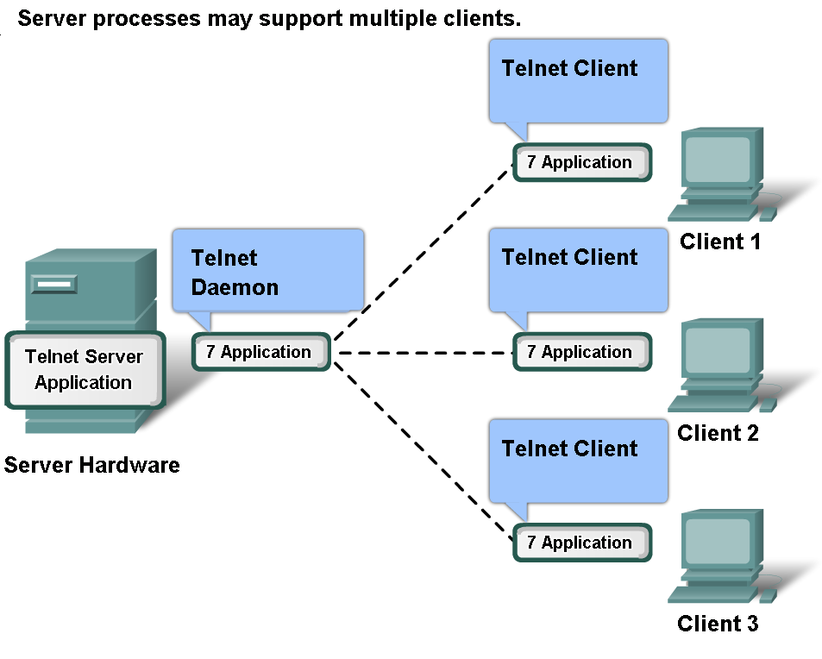
Application Layers services and protocols

Slide 9
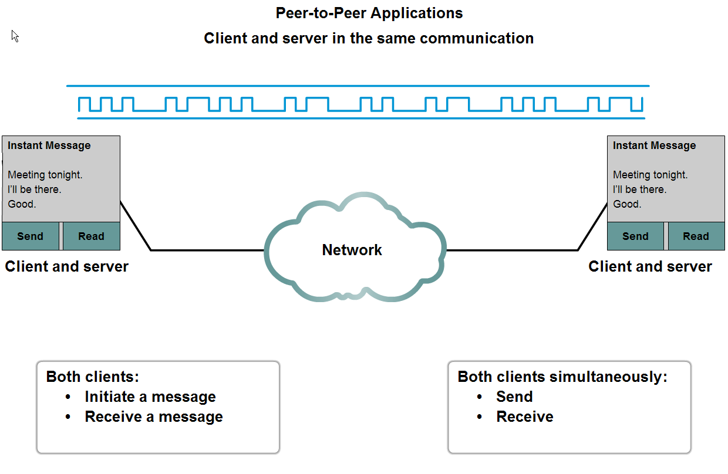
Compare and contrast client server networking with peer-to-peer networking and peer-to-peer applications

Slide 10
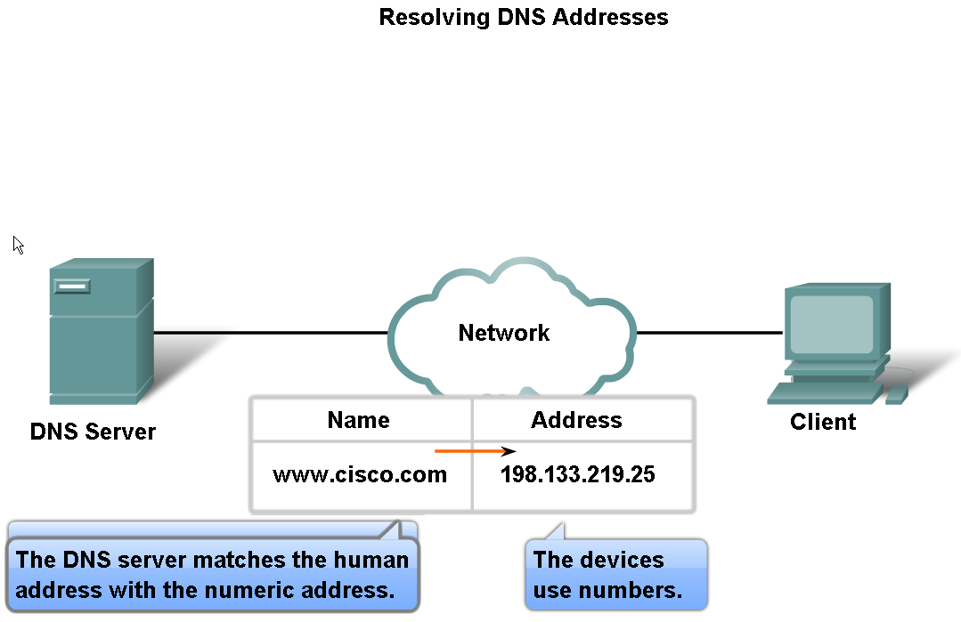
Features, Operation, and Use of TCP/IP Application Layer Services
The DNS protocol supports DNS services

Slide 11
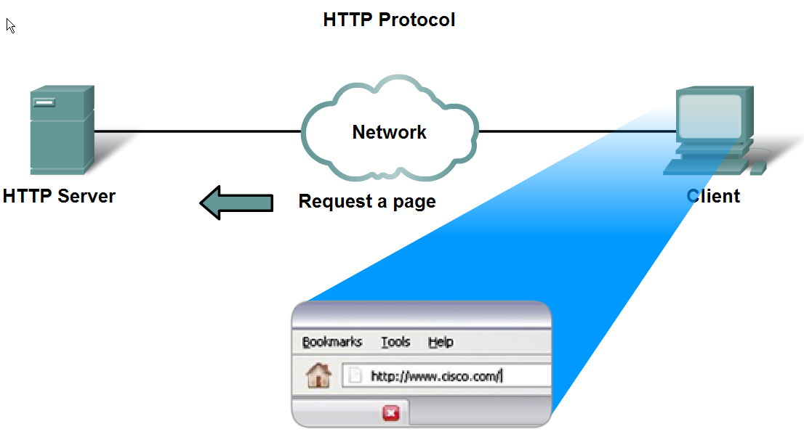
Features, Operation, and Use of TCP/IP Application Layer Services
HTTP protocol supports the delivery of web pages to the client

Slide 12
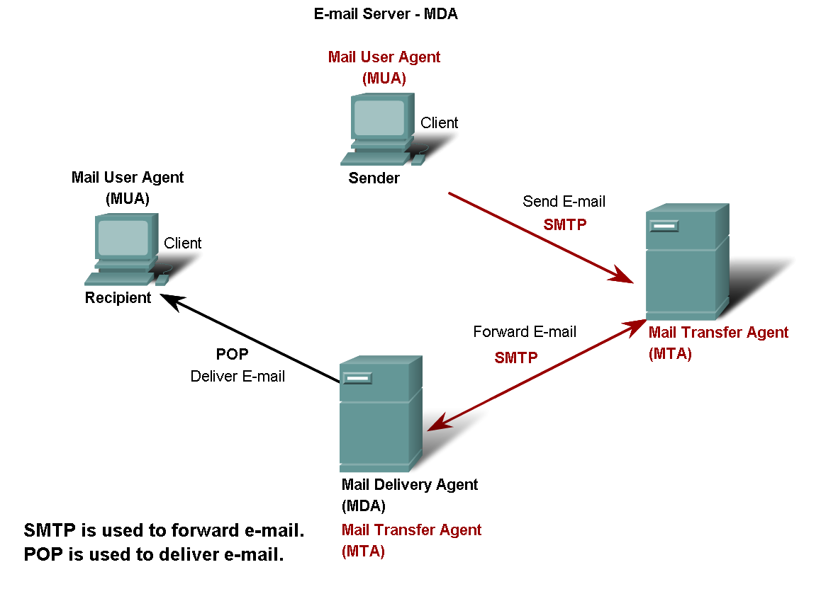
Features, Operation, and Use of TCP/IP Application Layer Services
POP and SMTP protocols support e-mail services

Slide 13
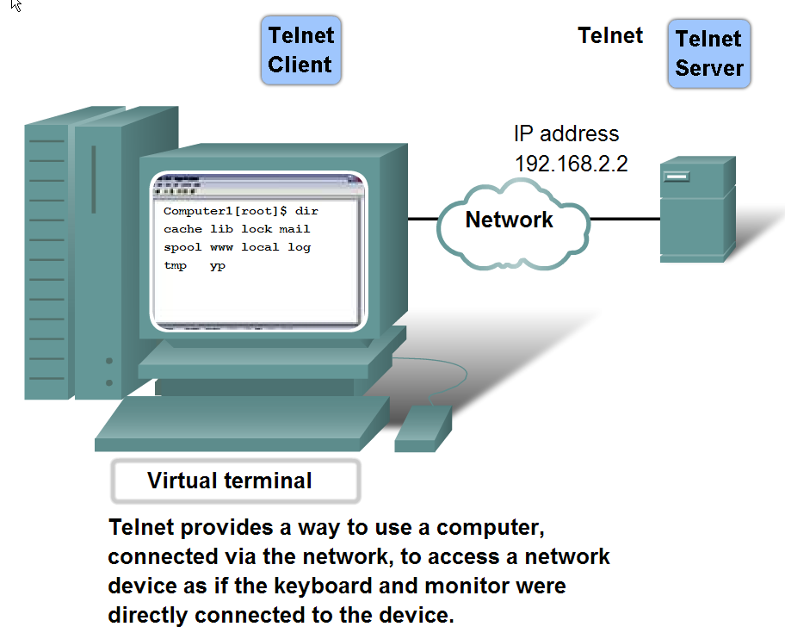
Features, Operation, and Use of TCP/IP Application Layer Services
The Telnet protocol is used to logon to remote networks and is used in network management.

